Slide 1



Making CMMC 2.0 Affordable
For SMBs
January 27, 2022

Slide 2
Agenda
Overview of CMMC 2.0
How companies can prepare for CMMC 2.0
CMMC 2.0 Case Study

Slide 3

About eFortresses
eFortresses, Inc. (a Gartner 2013 Cool Vendor and CMMC-AB approved Registered Provider Organization-RPO), is an AI powered Cybersecurity SaaS company that allows customers to self-assess, get validated, get trained, get certified, and reduce their breach probability at a fraction of the time and cost.
Our vision is to be the world's most trusted source for predicting and reducing cyber breach probability for both government and commercial sectors.
About Taiye Lambo
Founder & CTO, eFortresses / Founder, HISPI (CMMC-AB LPP)
Held Executive Leadership roles (CISO, vCISO, Director) at City of Atlanta and Federal Reserve Bank
32 years IT and 25 years Information Security on 4 continents
Author of Attribution: Social and Cyber Spaces on Amazon
Bachelor’s Degree in Electrical Engineering
Master’s Degree in Business Information Systems

Slide 4

About SAWTST
SAWTST, LLC is a defense contractor that provides customized IT solutions to help organizations coordinate and manage their supply chain and logistics operations. They are a Department of Veterans Affairs (VA) verified Service Disabled Veteran Owned Small Business (SDVOSB) with a legacy built on service.
About Kevin Dodson
Compliance Officer, SAWTST
Service Disabled Army Veteran
Bachelor's Degree in Business Administration
Master’s Degree in Information Systems Management
Master of Business Administration (MBA) in Operations Management
30 years of proven expertise in global logistics, information technology, and cyber security

Slide 5
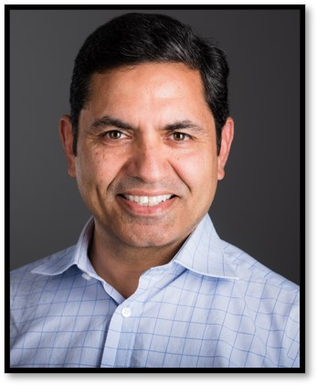
About PreVeil
PreVeil is a simple, inexpensive and secure Document Collaboration and Email platform for storing and sharing CUI and ITAR data.
Designed for the enterprise, PreVeil is used by leading defense contractors for CMMC compliance, Supply Chain Collaboration and Incident Response.
About Sanjeev Verma
Co-Founder & Chairman @ PreVeil since 2015
Previously, co-Founder Airvana
Business leadership roles, Motorola
MBA, MIT Sloan School of Management
BS Electrical Engineering, Delhi College of Eng.

Slide 6
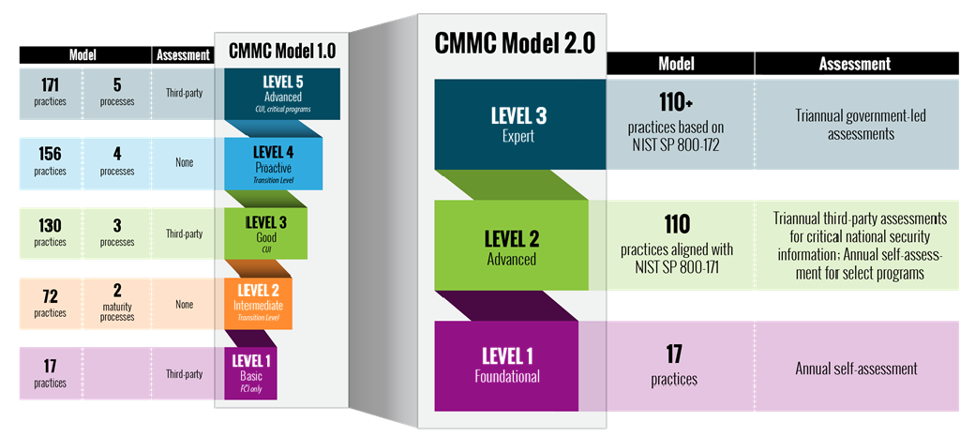
CMMC 1.0 to CMMC 2.0

Slide 7
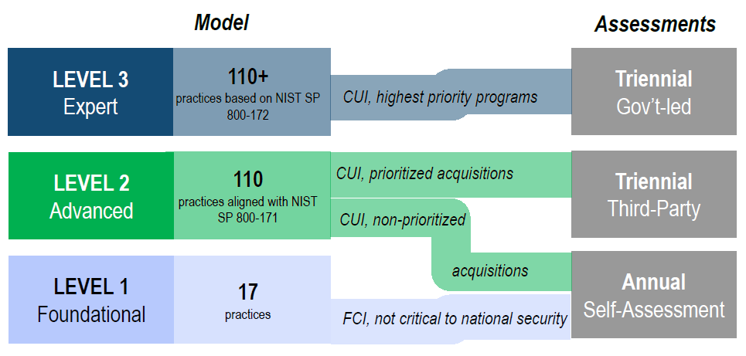
Overview of CMMC 2.0

Slide 8
PreVeil + eFortresses = 3 Step Compliance
Simple, Secure, Low Cost
The purpose of CMMC is to protect CUI
Compliance is the way to demonstrate security of the CUI
CMMC 2.0 Makes attaining Level 2 Compliance Simpler, Less Expensive
PreVeil SMB customer achieved perfect 110/110 in DIBCAC audit

Slide 9
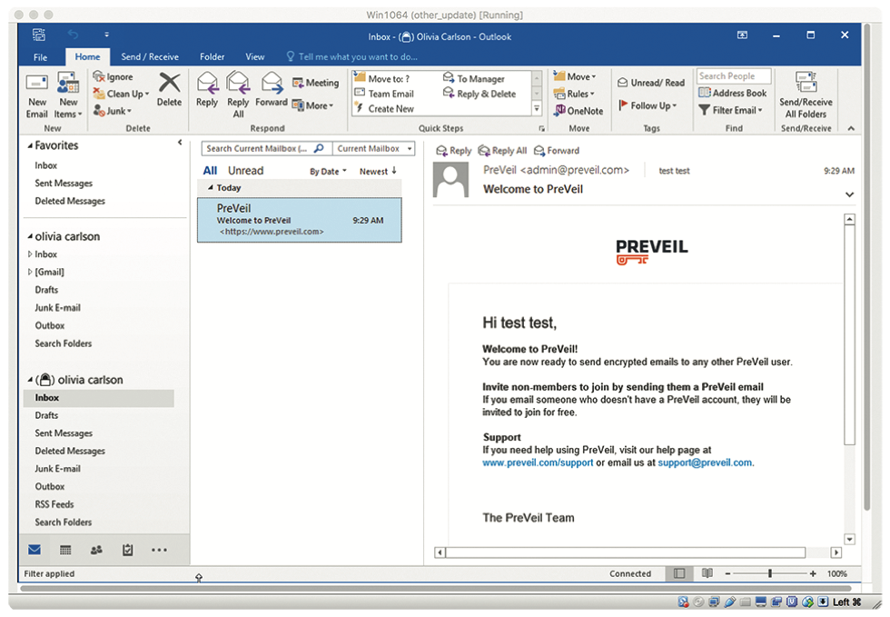
Step 1: Add PreVeil to existing O365/Gsuite/Exchange
Deploy In Hours, Only to Users that handle CUI > CUI Secured in Files, Email
Saves time, money, protects CUI with Zero Trust Security
Meets NIST 800-171 DFARS Requirements
Encrypted Drive
Encrypted Email

Slide 10
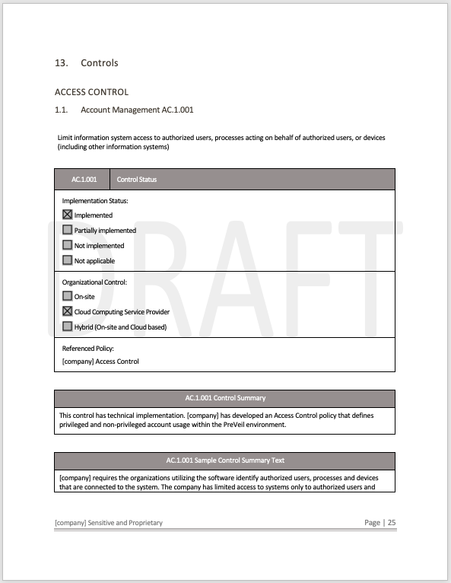
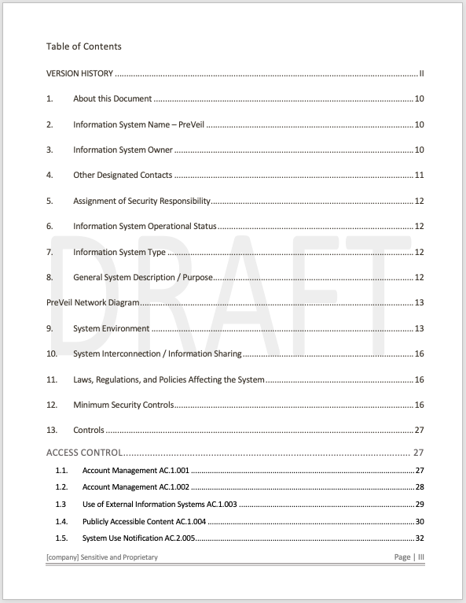
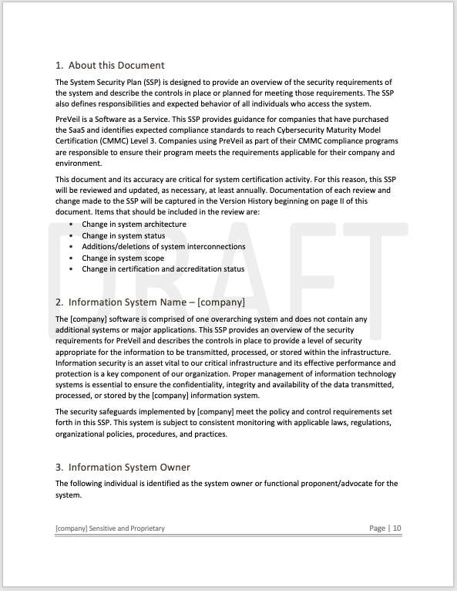
Step 2: SMB Uses PreVeil CMMC Documentation to Develop SSP
SMB gets System Security Plan
PreVeil Offers a Comprehensive SSP and Policy template for customers
Addresses 85 Controls Covered by PreVeil
Strong Baseline SPRS Score (40+)
200+ Pages Detailed Document
CMMC, ITAR, NIST 800-171

Slide 11
Step 3: SMB Address remaining gaps with eFortresses SaaS & vCISO Service
SMB gets Full System Security Plan
Take Baseline Score from 40 > 100+
Prepared for Audit
If any Audit findings, eFortresses helps rectify with POAM
CMMC, ITAR, NIST 800-171

Slide 12
Compliant
110 😊
CMMC 2.0, NIST 800-171, ITAR

Slide 13
PreVeil Compliance Basics
PreVeil is a SaaS Cloud Service
  FedRAMP Baseline Moderate Equivalent
  All PreVeil Data is Stored on AWS Gov Cloud FedRAMP High by Default
  FIPS 140-2 Validated Encryption
  DFARS 7012 c-g compliant

Slide 14
PreVeil Email and Drive Videos
PreVeil Email: https://vimeo.com/412810970
PreVeil Drive: https://vimeo.com/412810912

Slide 15
Q&A

Slide 16
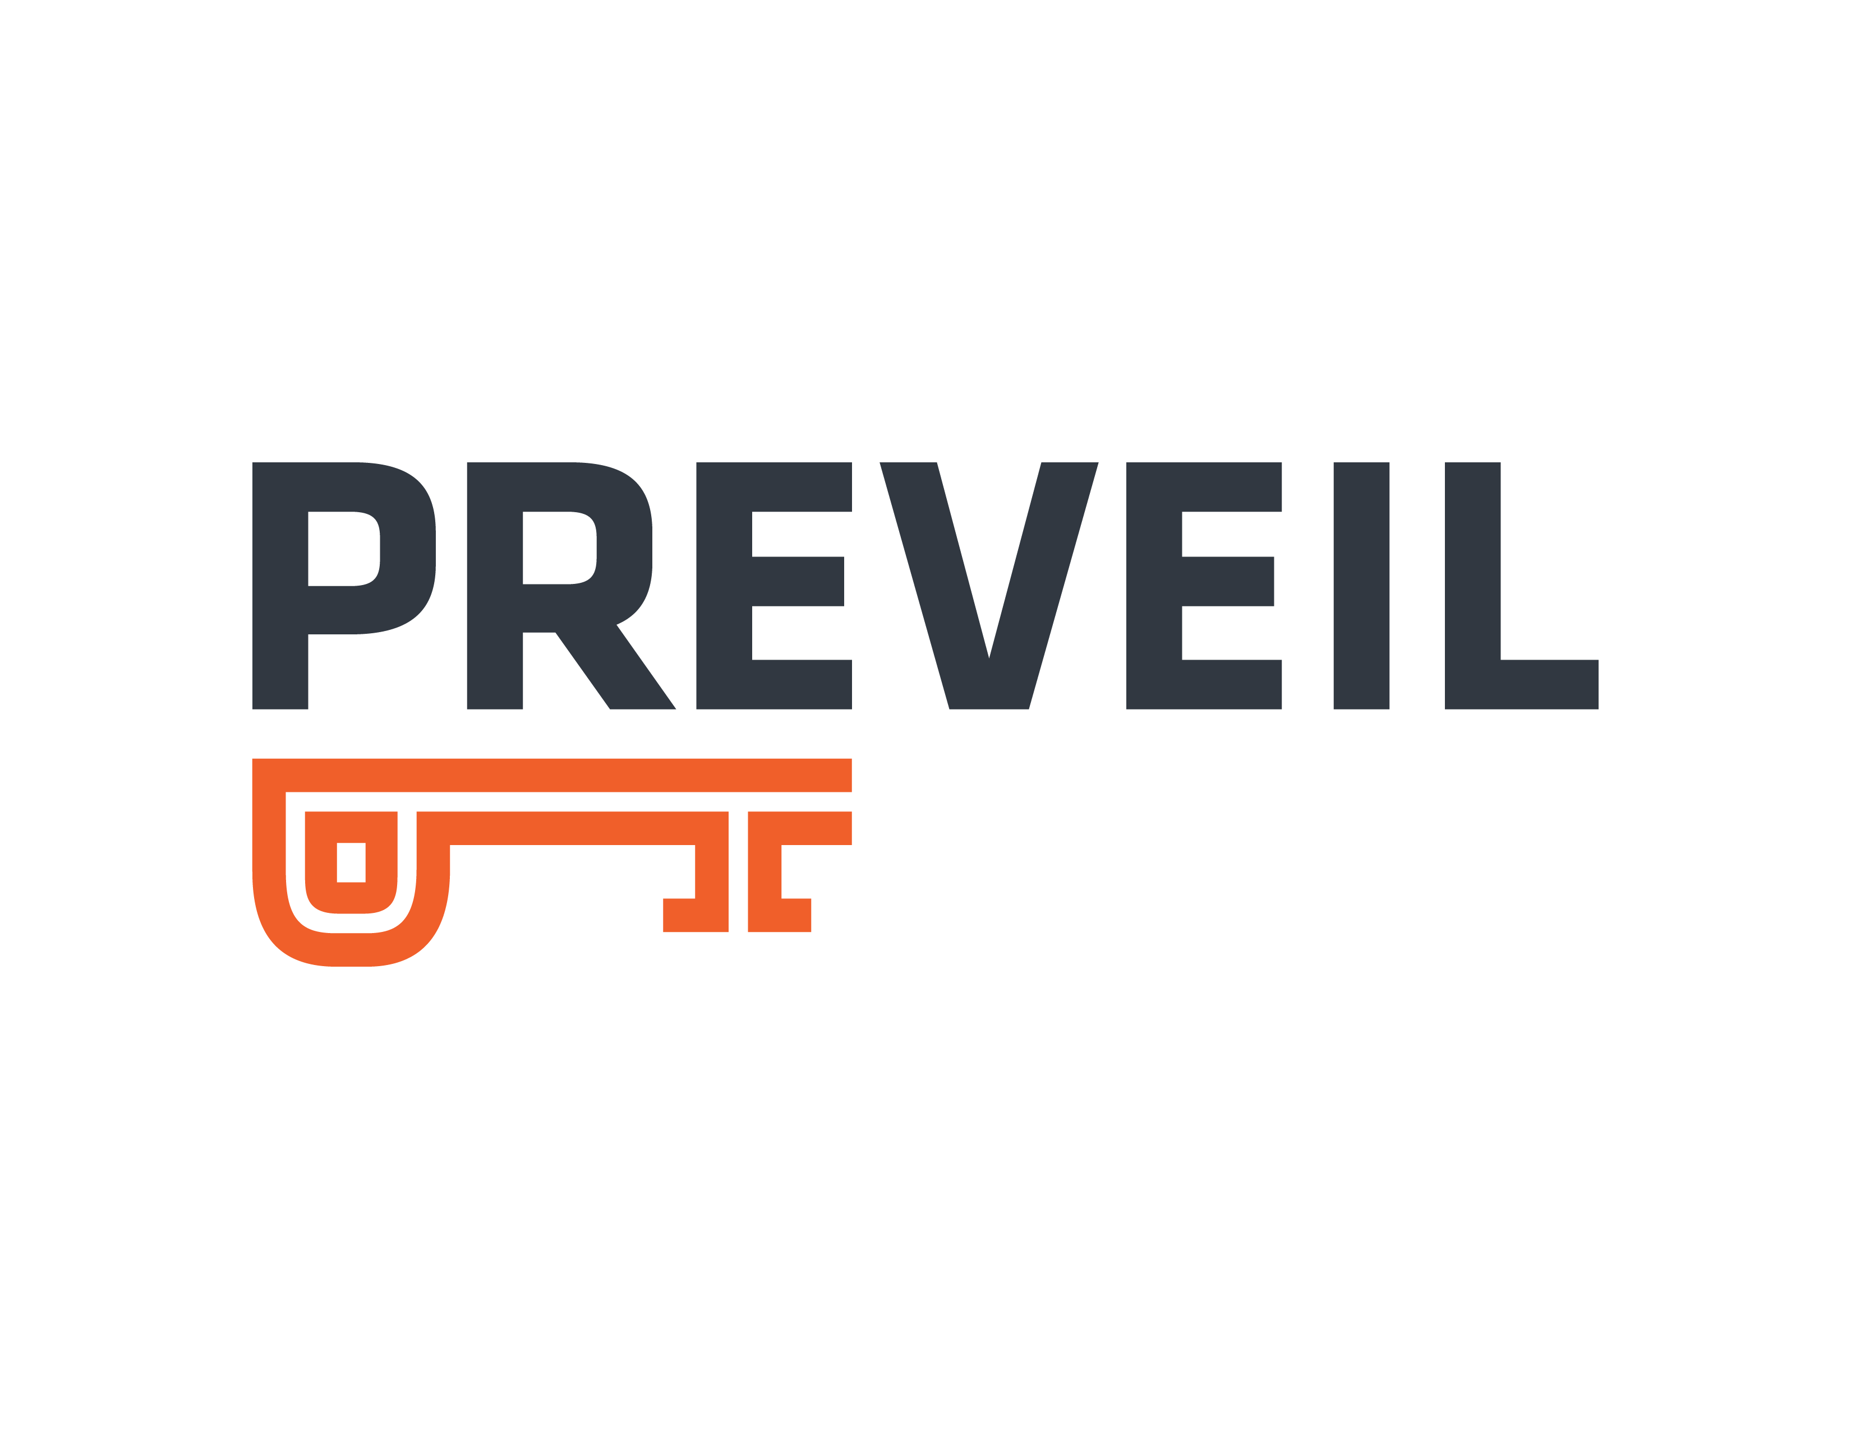

Follow-up
eFortresses.com
sawtst.com
preveil.com
tlambo@efortresses.com
Kevin.Dodson@sawtst.com
sanjeev@preveil.com
678-886-3912
601-462-4200
857-353-6480

