Slide 1


The CMMC Documentation Challenge
March 16, 2022

Slide 2
Documentation Examples

Slide 3
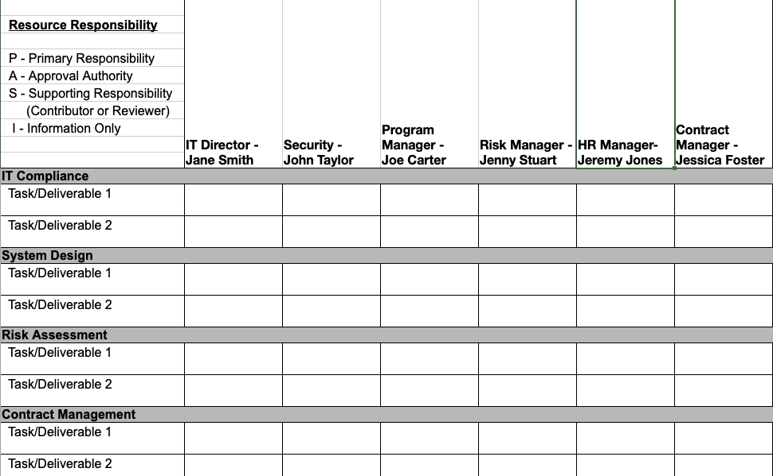
Access Control
Assigned Responsibilities
An Assigned Responsibilities Matrix (RAM) should include:
  Responsibilities/Tasks to be completed
  Roles that will complete those tasks
  Individuals within those roles that will be addressing those tasks

Slide 4
Awareness and Training
Employee Training Log
Employee Name | Training Name | Date of Training | Training Administrator | Frequency of Training
Employee 1 | Training 1 | 1/1/2022 | John Smith | Quarterly
Employee 2
Employee 3
Employee 4
Training Documentation
There are multiple types of Training documentation including, Role based training, Security Awareness Training, and Insider Threat Training.
All training must be documented in an Employee Training Log that includes the following information:
    Name of Training
    Date of Training
    Employee Who Took the Training
    Training Administrator
    Frequency of Training

Slide 5
Audit and Accountability
Auditable Event List
Auditable Events
Windows Event ID | Potential Criticality | Event Summary | Rationale
4618 | High | A monitored security event pattern has occurred. | Investigate immediately
4649 | High | A replay attack was detected. May be a harmless false positive due to misconfiguration error. | Investigate immediately
4892 | Medium | A property of Certificate Services changed. | Monitor for unexpected occurrences
4720 | Low | A user account was created. | Monitor for increased occurrences
An Auditable Event List should include the following:
    Unique Event IDs
    Event description
    Intended use (passive monitoring, use in analysis or reporting, alerting for immediate investigation)

Slide 6
Configuration Management
Baseline Configurations
Asset | Operating System | Applications Installed | Patch Version | Antivirus Solution
Computer 1 | Windows 11 | MS Office | 21H2 | MS Defender
Computer 2
Computer 3
Computer 4
Baseline Configuration/
Asset Inventory
A Baseline Configuration should include:
    Operating System
    Applications Installed
    Major Version (if applicable)
    Antivirus Solution

Slide 7
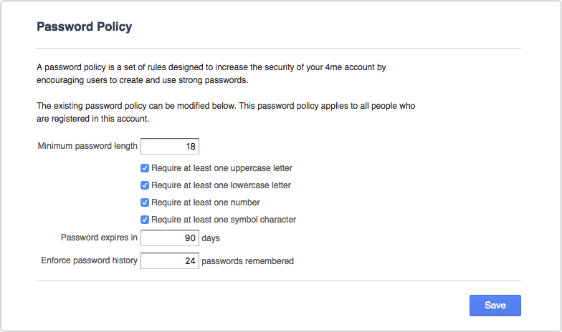
Identification and Authentication
Password Policy
A Password Policy should include:
    The minimum password complexity permitted
    Password reuse
    Frequency of password change

Slide 8
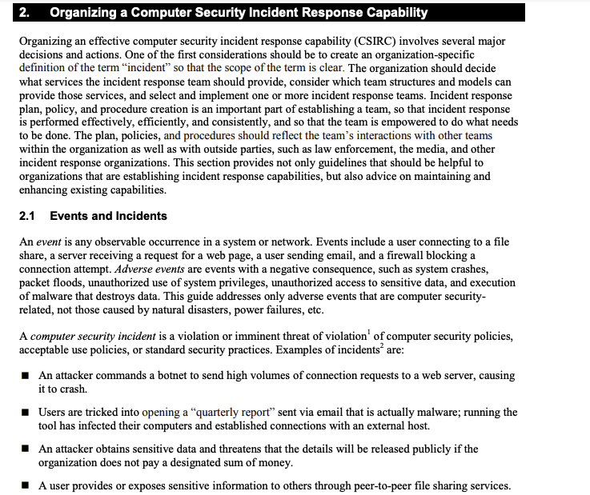
Incident Response
Incident Response Plan
An Incident Response Plan should include:
    Incident Handling
    Incident Reporting
    Incident Response Testing
Screenshot from NIST IR Plan Template: https://nvlpubs.nist.gov/nistpubs/specialpublications/nist.sp.800-61r2.pdf

Slide 9
Maintenance
Maintenance Schedule
Asset | Maintenance Type | Maintenance Performed | CUI? | Date Maintenance Performed | Maintenance Performed By
Computer 1 | Corrective | Reinstalling drivers | No | 1/1/2022 | John Smith
Computer 2
Computer 3
Computer 4
Maintenance Schedule
A Maintenance Schedule should include:
    Maintenance Type (predefined in the SSP)
    Maintenance Performed
    Date Performed
    Authorized Resource Who Performed Maintenance
    CUI Status

Slide 10
Media Protection
Media Sanitation Record
Media | Asset Number | Encryption Status | CUI? | Sanitization Method | Sanitization Method Performed By
CD | 1 | Not Encrypted | No | Shred | Jane Smith
USB Drive
DVD
Disk
Media Sanitation Records
A Media Sanitation Record should include:
    Type of media being sanitized
    Asset number, if applicable
    Media encryption status
    Authorized method of sanitation applied
    Authorized resource applying sanitation method
    CUI Status

Slide 11
Personnel Security
Personnel Screening Records
Personnel Screening Records
Personnel Screened | Type of Screening - Based on Role | CUI Access? | Date of Screening | Method of Screening | Results of Screening | Screening Initiated By
John Smith | IT Resource | Yes | 1/1/2022 | ACME Background Checks | None | Jenny Thompson
Jane Foster
Mark Miller
Tom Phillips
A Personnel Screening Record should include:
    Personnel Information
    Personnel Role Based Screening, if applicable
    Date of Screening
    Method of Screening
    Results of Screening - Issues
    Authorized Resource Performing (Initiating) Screening
    CUI Access Status

Slide 12
Physical Protection
Visitor Logs
Visitor | Reason for Visit | Date of Visit | Personnel Escorting | Area(s) of Access | CUI Access?
Visitor 1 | Meeting | 1/1/2022 | Jane Smith | Conference Room | No
Visitor 2
Visitor 3
Visitor 4
Visitor Logs
A Visitor Log should include:
    Visitor Name and Contact Information
    Date of Visit
    Reason for Visit
    Personnel Responsible for Escorting the Visitor
    Areas of Access
    CUI Access Status

Slide 13
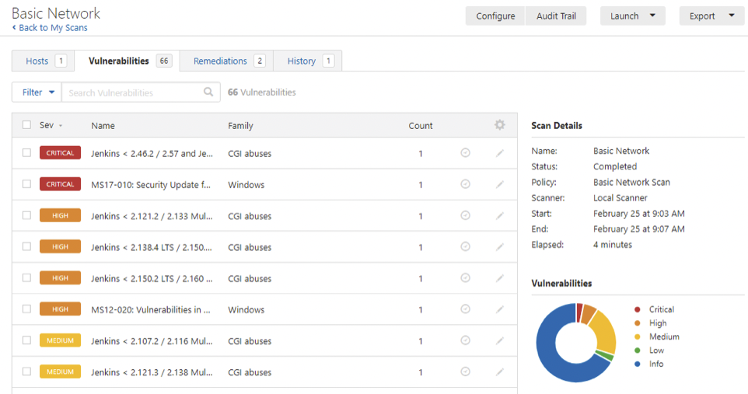
Risk Assessment
Vulnerability Scanning
Reports
A Vulnerability Scanning Reports should include:
    Vulnerability Identified
    Date First Identified
    Assets Affected by Vulnerability
    Severity of Vulnerability

Slide 14
Security Assessment
Plan of Actions and
Milestone (POA&M)
POA&M
POA&M Number | POA&M Detail | POC | Planned Start Date | Planned Completion Date | Actual Start Date | Actual Completion Date | Planned Actions to Address POA&M Item | Deviations for Planned Actions? (Y/N) | Explanation of Deviations | Milestones | Status
POA&M Item 1 | MFA Solution | Taylor Brown | 1/1/2022 | 2/28/2022 | 1/5/2022 |  | Purchase and Install MFA Solution | No | N/A | -Compare MFA Solutions -Purchase MFA - Install MFA | In Progress
POA&M Item 2
POA&M Item 3
POA&M Item 4
A POA&M should include:
    POA&M Item Explanation
    POC for POA&M Item
    Planned Start and Completion Dates
    Actual Start and Completion Dates
    Planned Actions
    Any Deviations from Planned Actions
    Explanation of Any Deviations
    Milestones
    Status

Slide 15
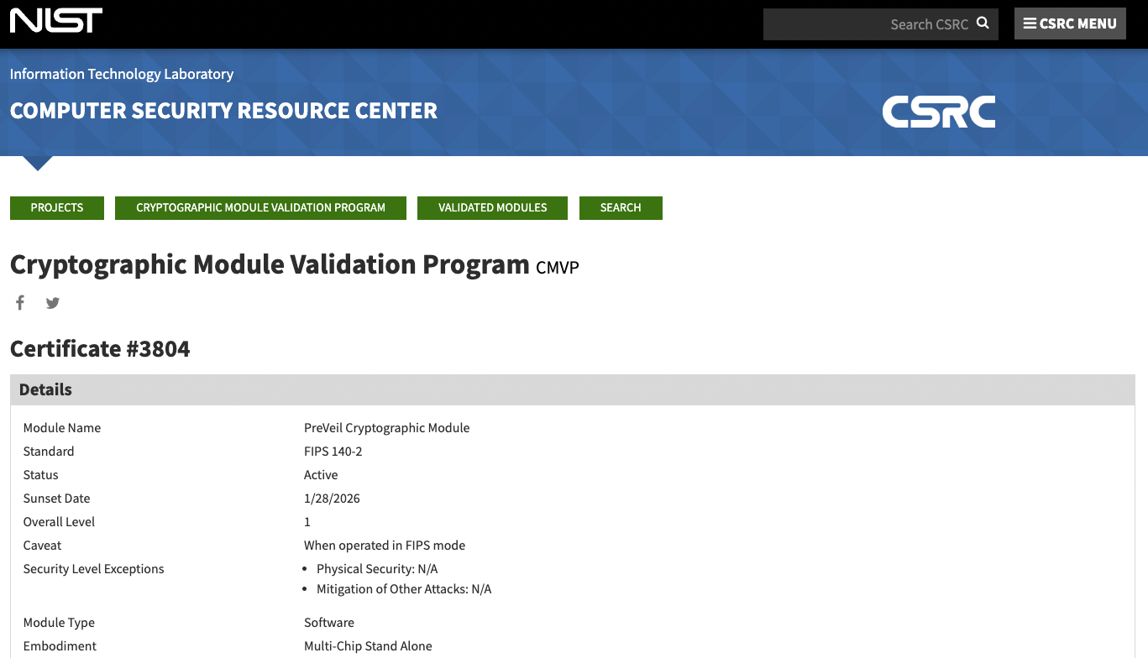
Security and Communications Protection
FIPS Validation
Certificates
For security protections, ensure FIPS 140-2 validation
FIPS validation certifications can be found on the NIST Computer Security Resource Center

Slide 16
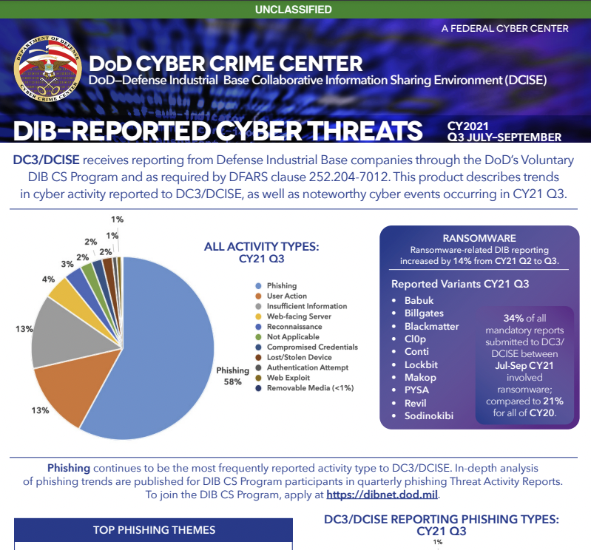
System and Information Integrity
Security Alerts and Advisories
Singing up, reviewing and taking necessary action in response to security alerts, advisories, and directives from reputable external organizations, such as:
    Security Agencies
    DoD Agencies
    Independent IT Security Organizations

Slide 17
Finis

Slide 18

Contact Information
Defcert.com
Preveil.com
info@defcert.com
compliance@preveil.com

